Slide 1
Michael C. Kirchner

Slide 2
About Mike Kirchner
Professional Experience & Education
  College Info
  Job at Wyatt
Volunteer & Community Involvement
  I was coach of xxx.
  Worked at soup kitchen.
Personal
  I have two sons, xx and xx years old.
  I have lived in Highland Heights for xx years.
  I enjoy skiing, tennis, hiking and cooking. I make a fabulous xxx.

Slide 3
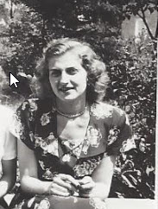
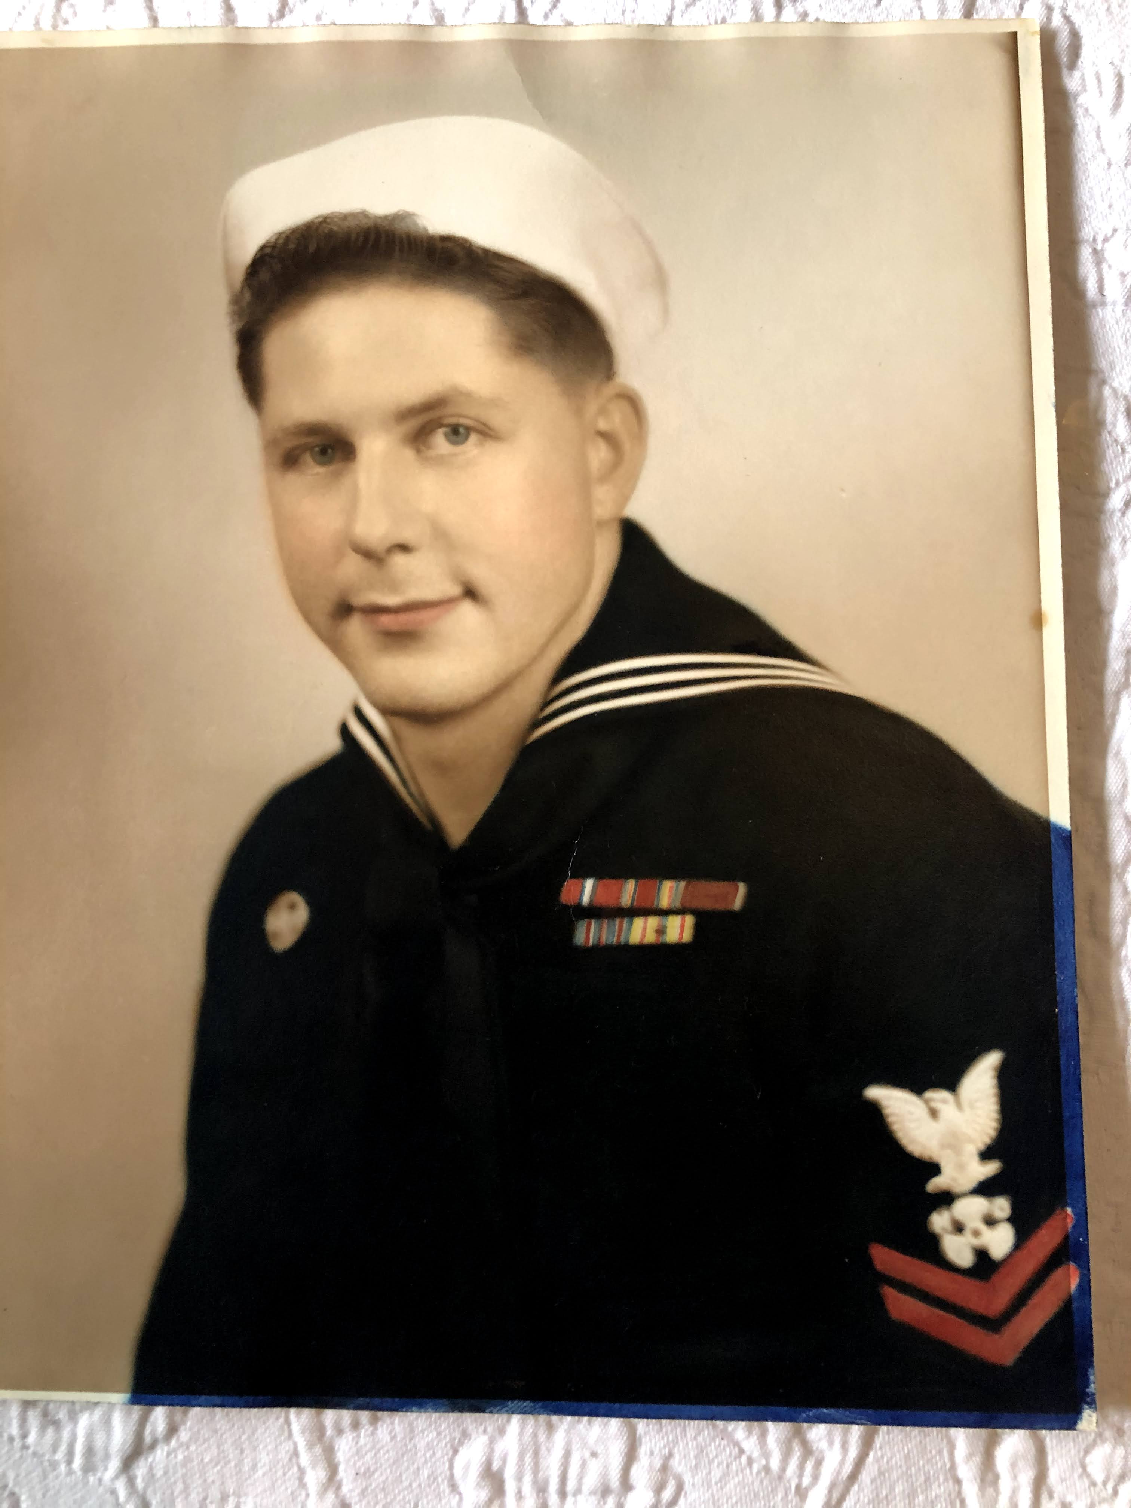
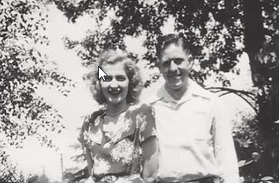
Mike Kirchner’s Parents
They fell in love with a wink from Dad!
My Dad John a WW II Navy Veteran.
My Mom Martha an Office Secretary.

Slide 4
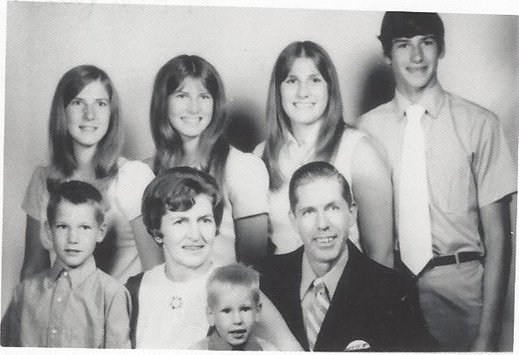
The Kirchner family
The Kirchner family grew to six with three girls followed by three boys. I was the fifth child (lower left).

Slide 5
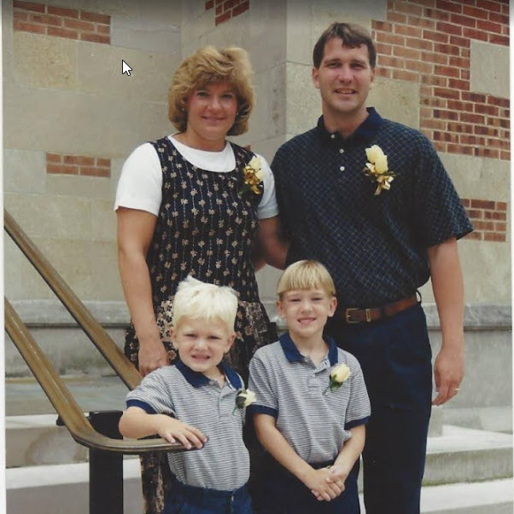
Mike in married life
Mike with wife Sue and boys Jake and Bobby.

Slide 6
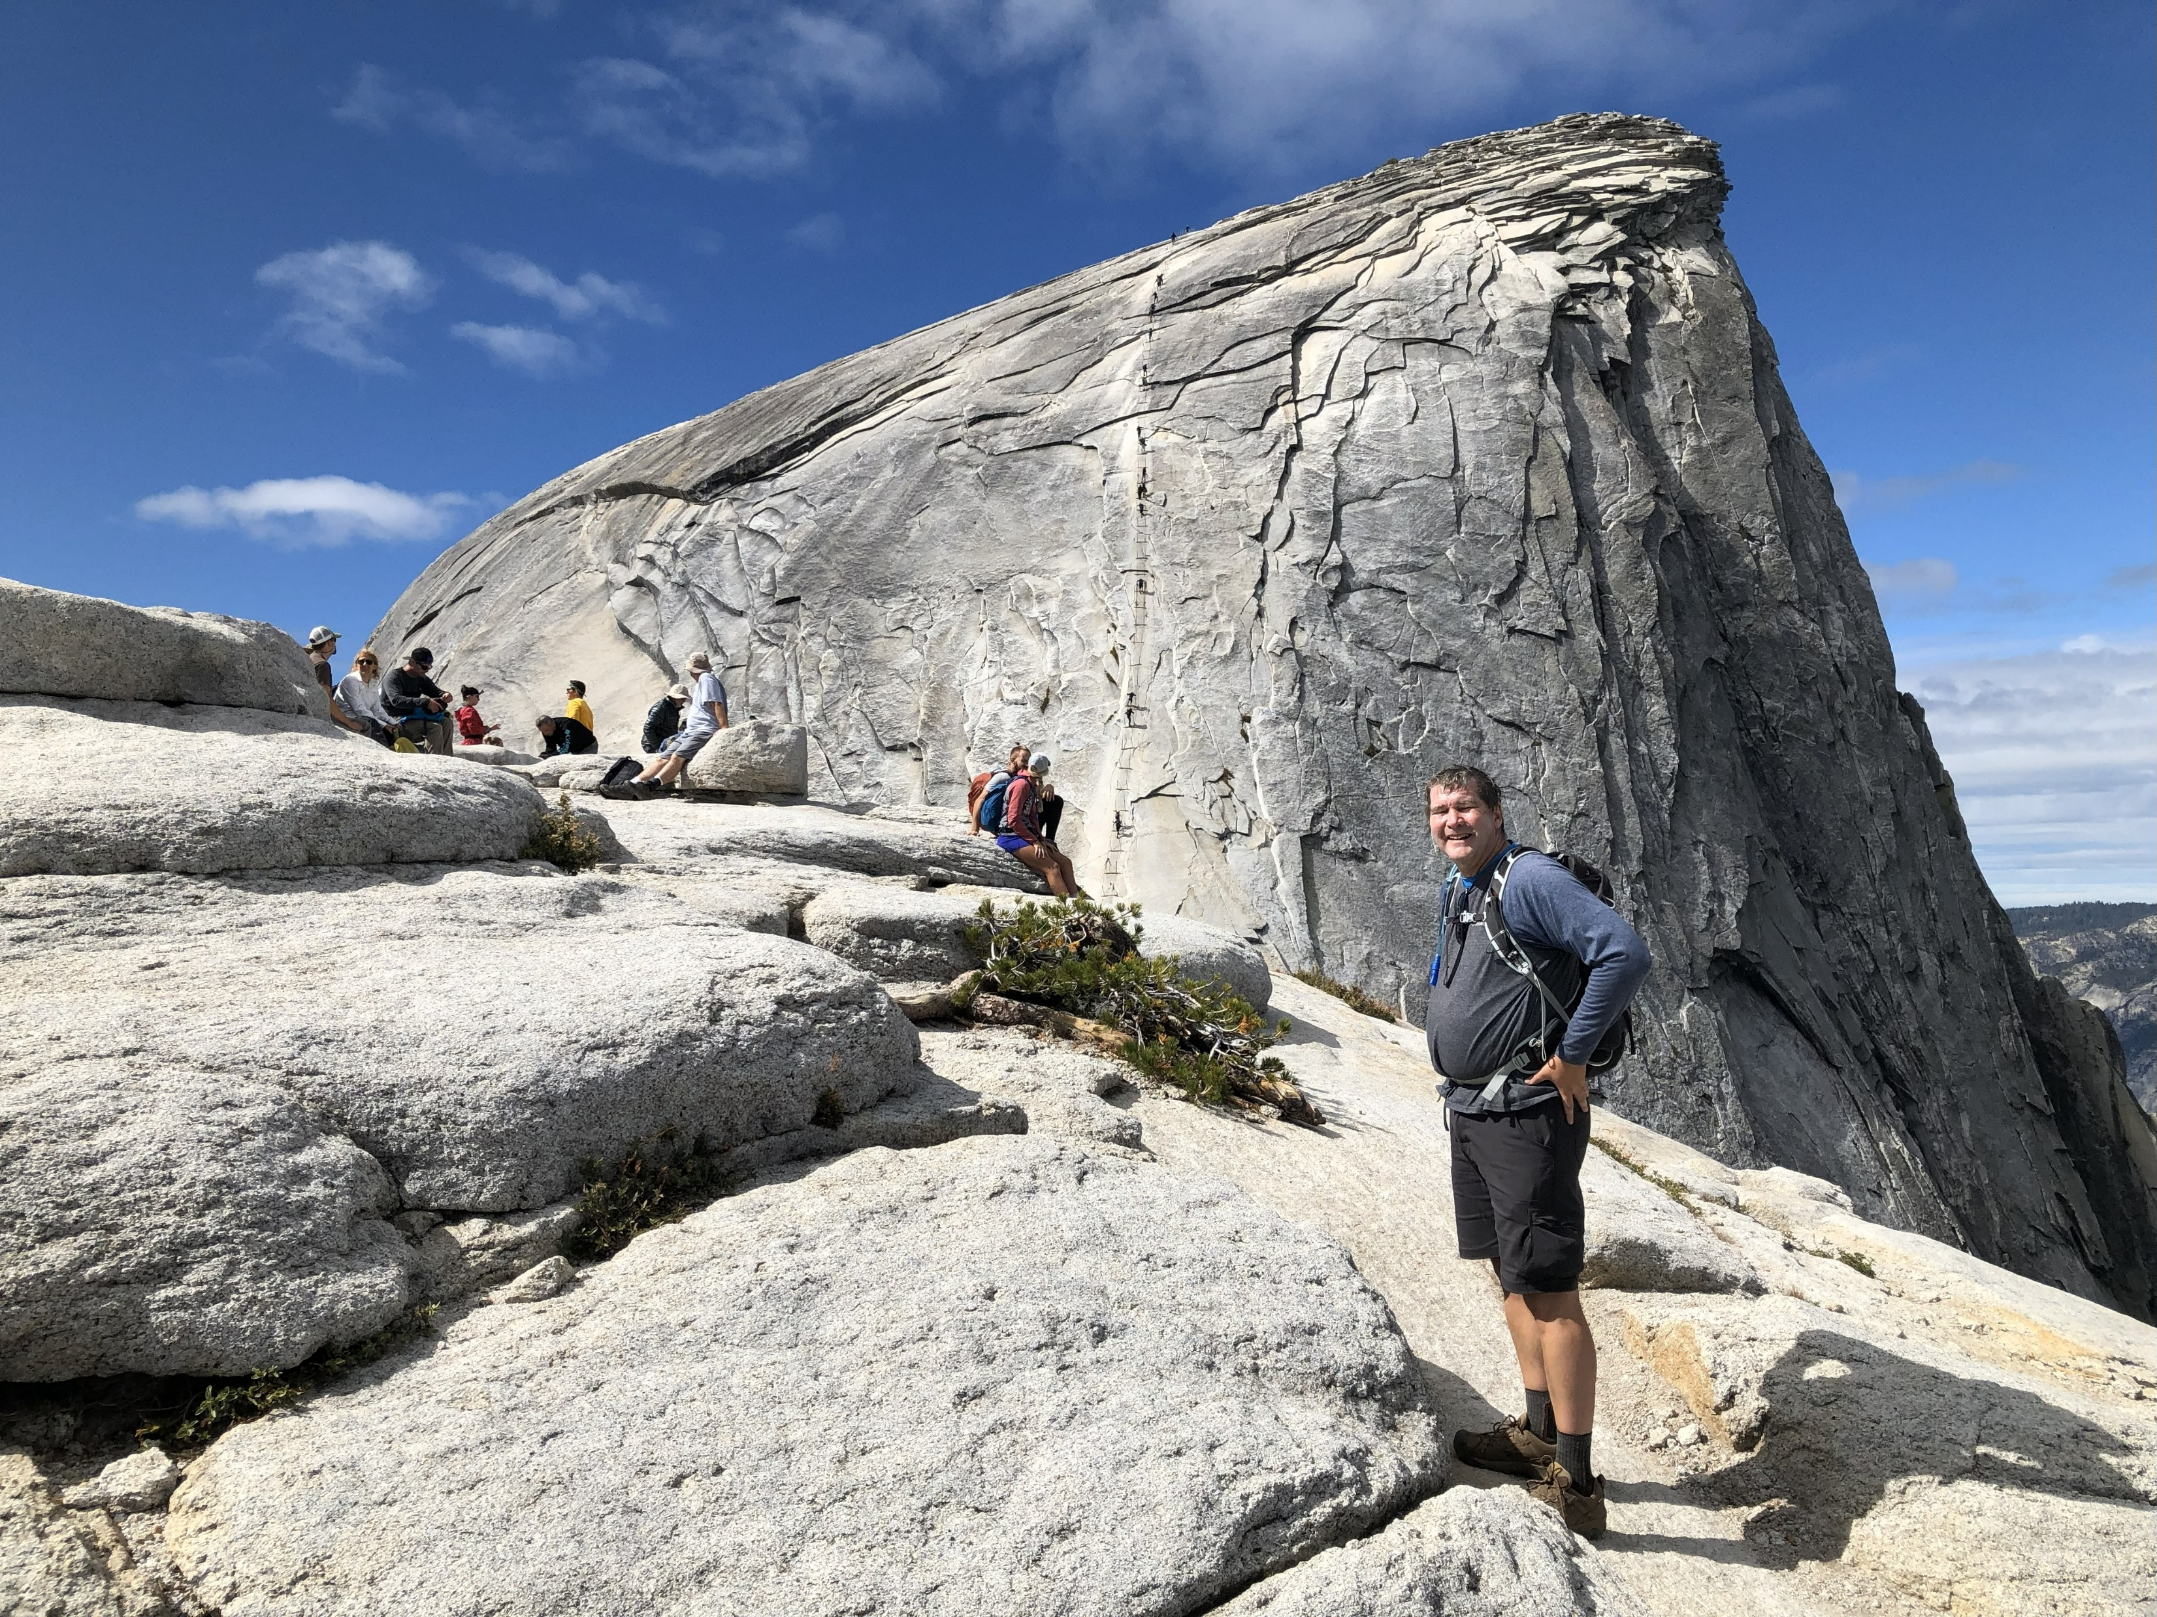
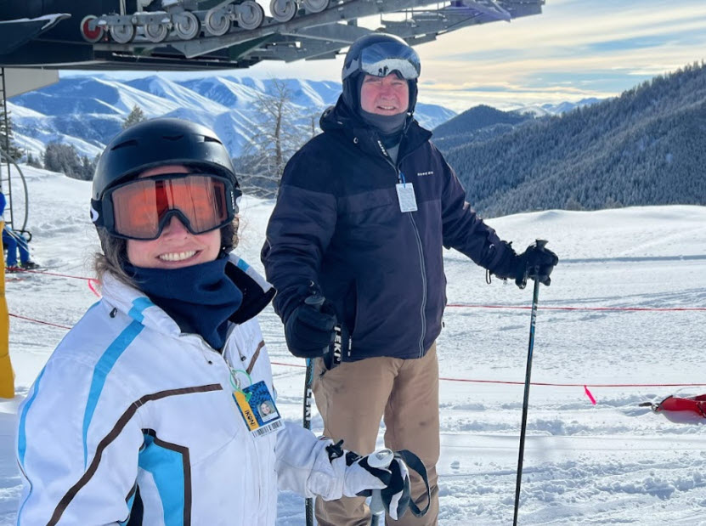
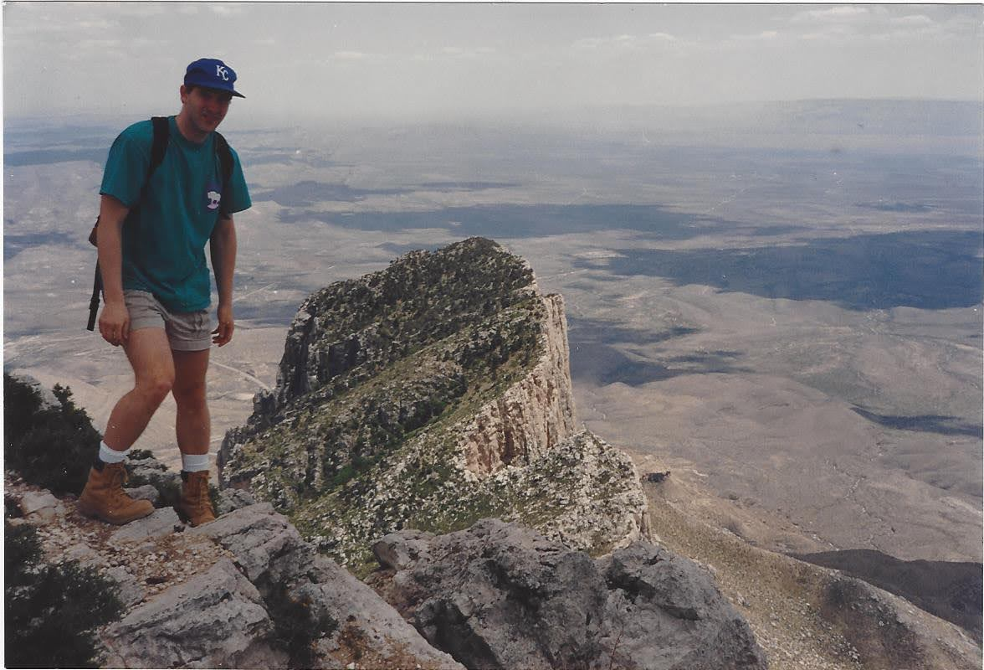
Mike’s Adventures

Slide 7
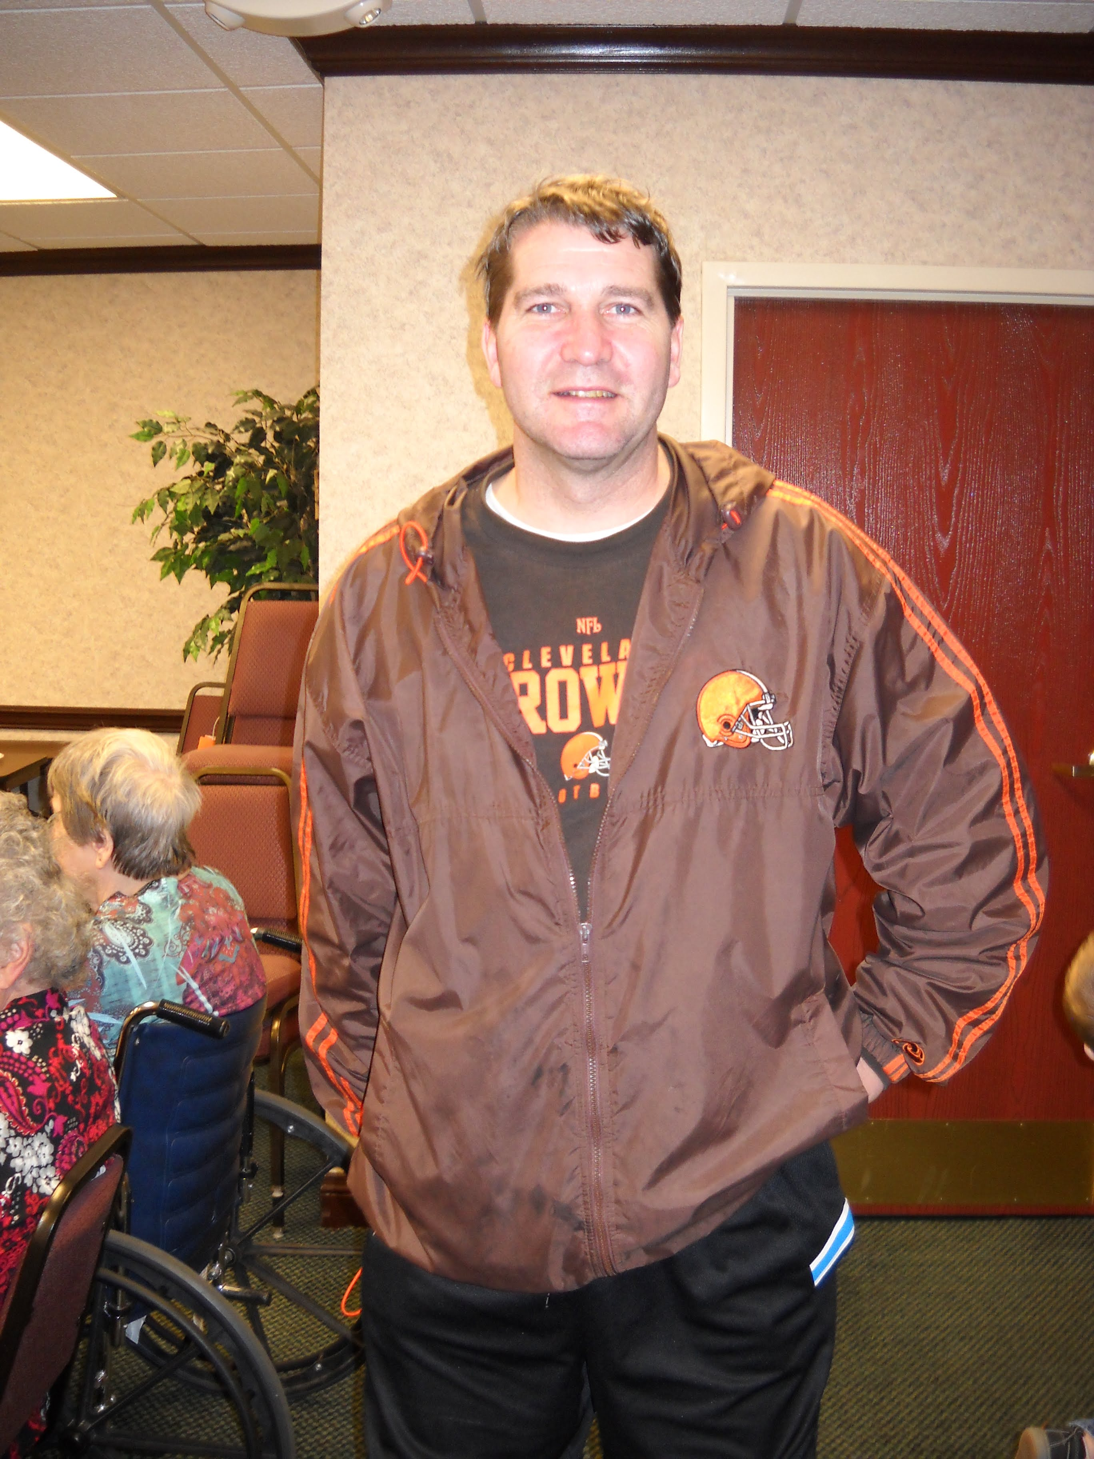
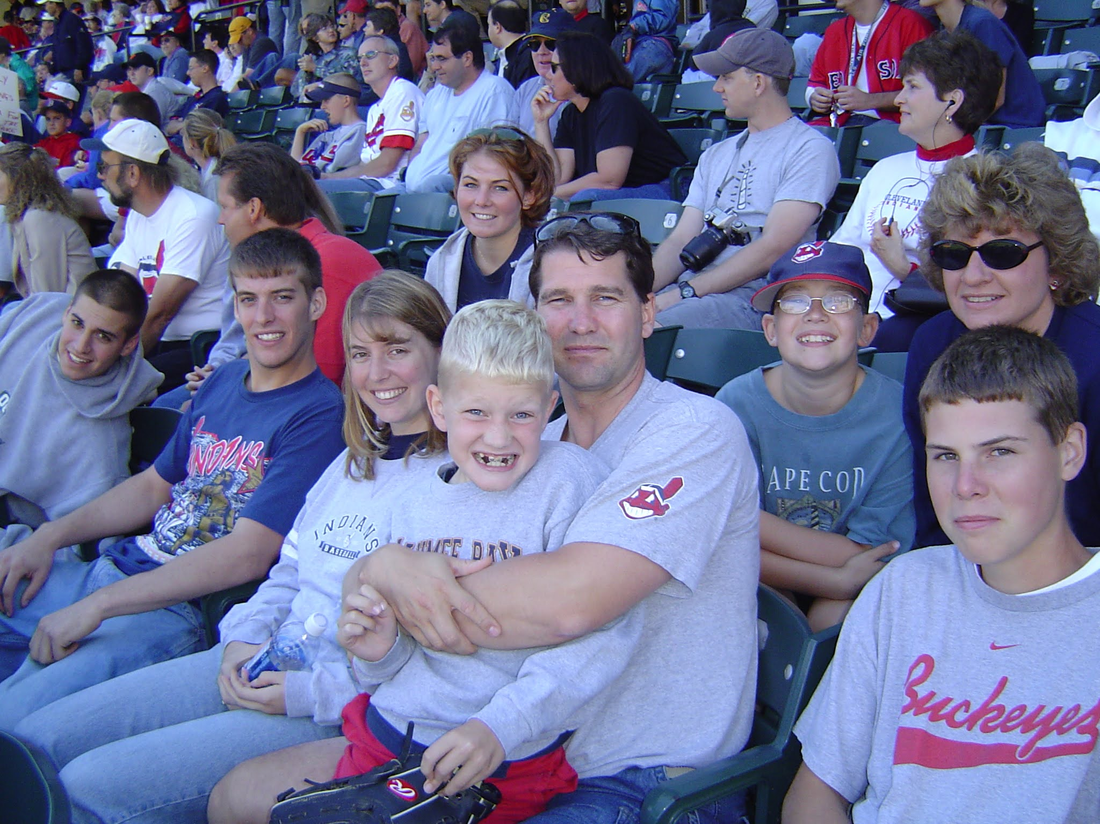
Mike – a die-hard Cleveland Fan

Slide 8
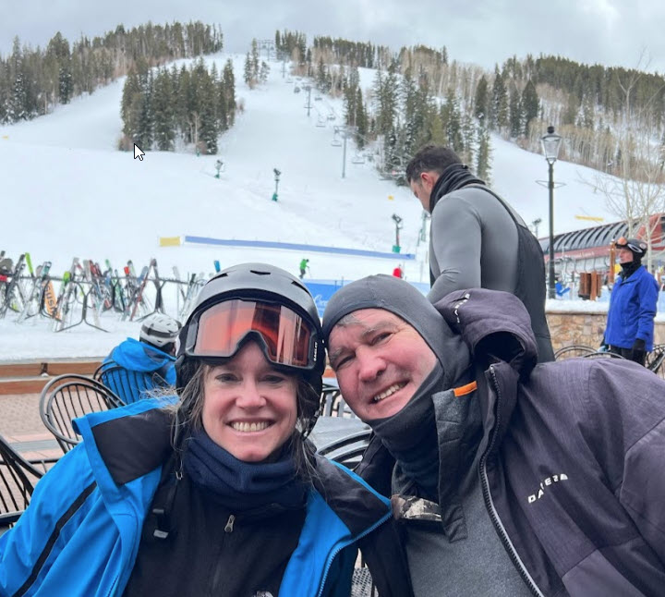
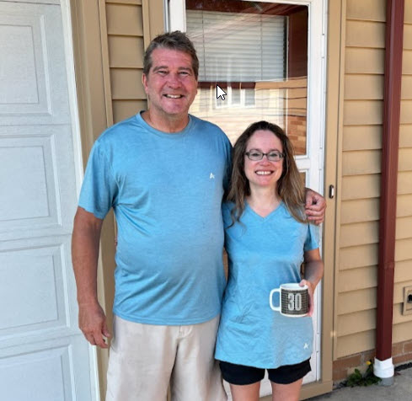
Mike and Audrey

